Slide 1
Project Migalka
PiK team

Slide 2
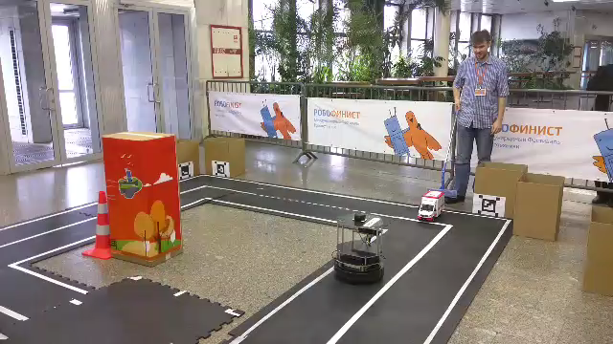

Slide 3
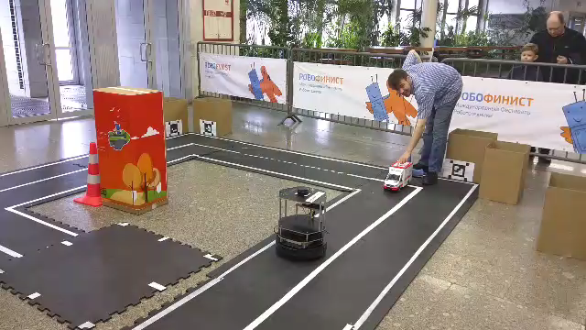

Slide 4
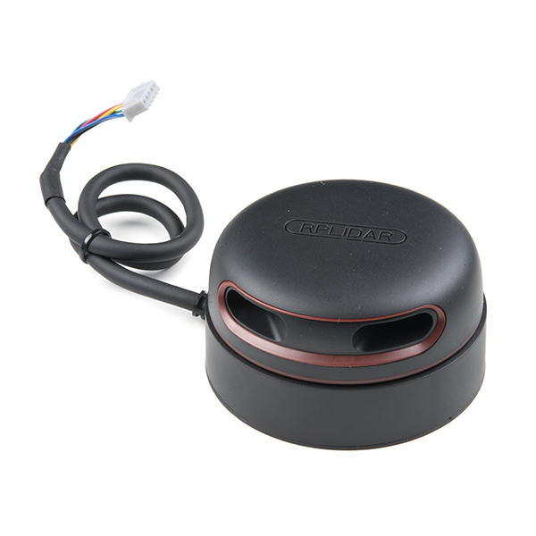

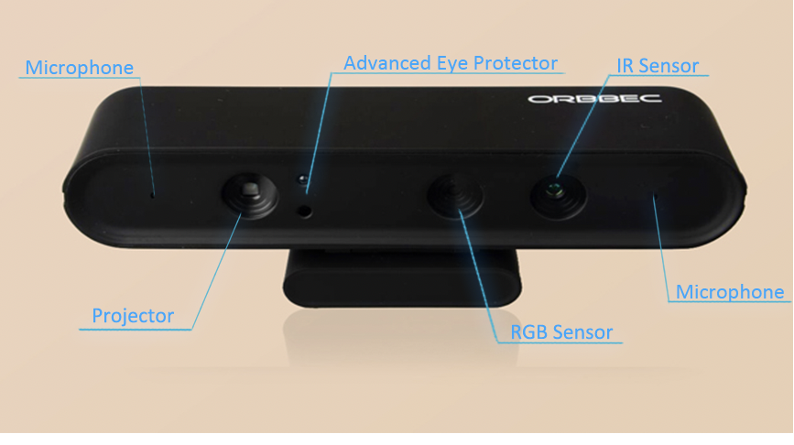
Start
Stop
Image Handler
Scanner Handler
Sound Handler

Slide 5
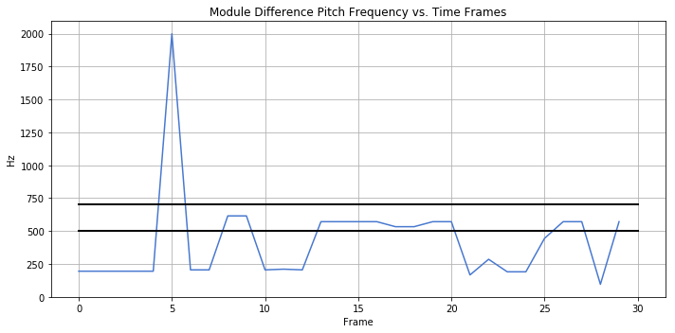
Sound Handler: trigger
Post-processing of autocorrelation function of the audio frames
Emergency siren is in [500Hz, 700Hz] frequency band

Slide 6


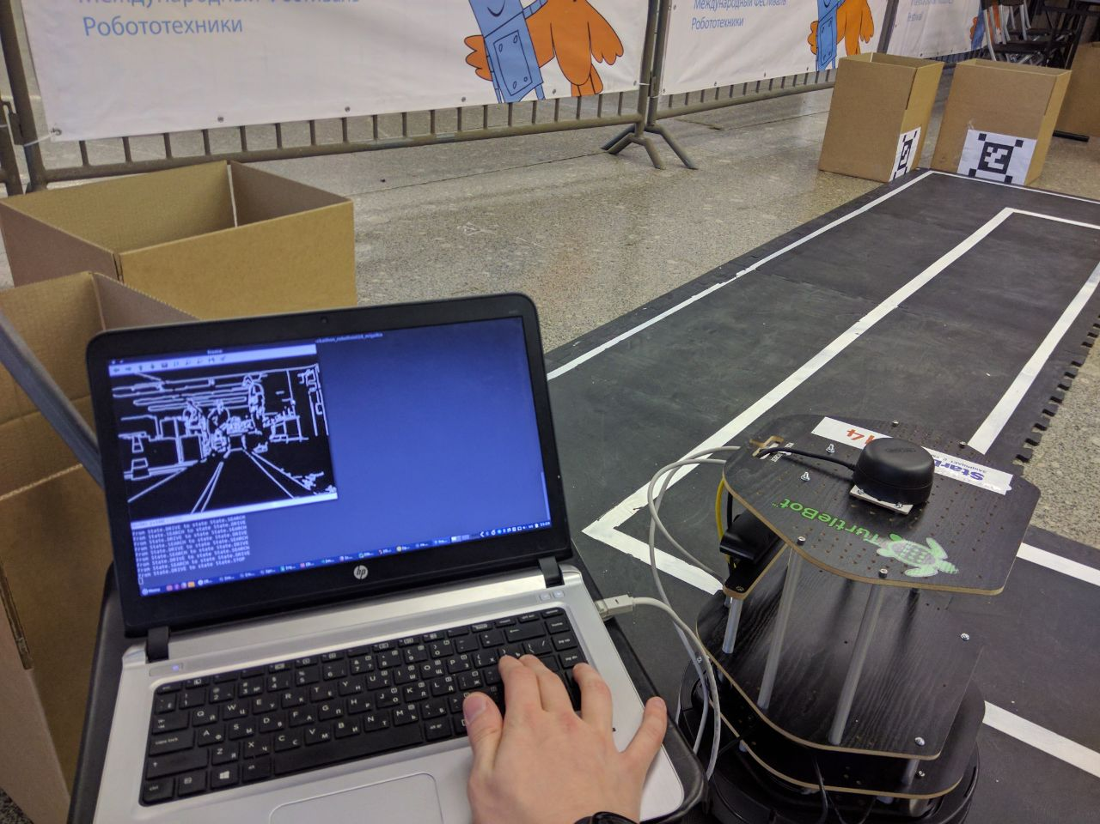
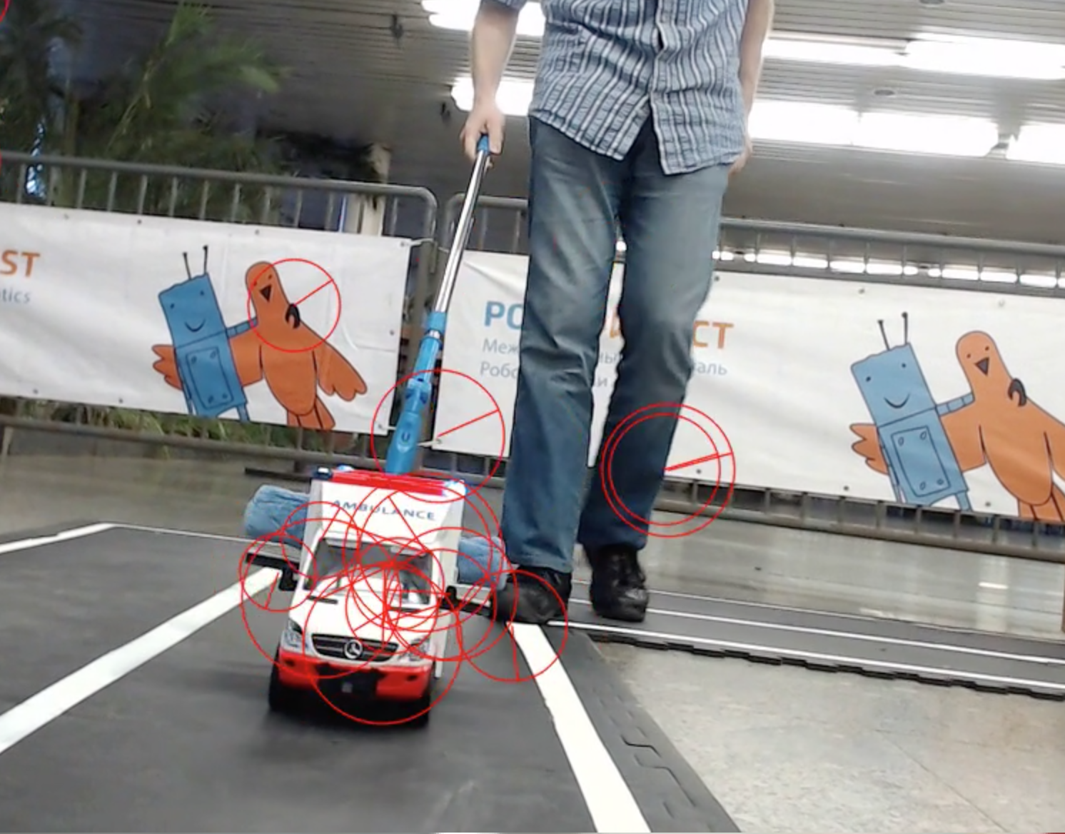
Image Handler
Image Handler
Navigation
Trigger

Slide 7

Image Handler: trigger
Image
Rotation- and scale-invariant
template matching
+
scanner trigger

Slide 8
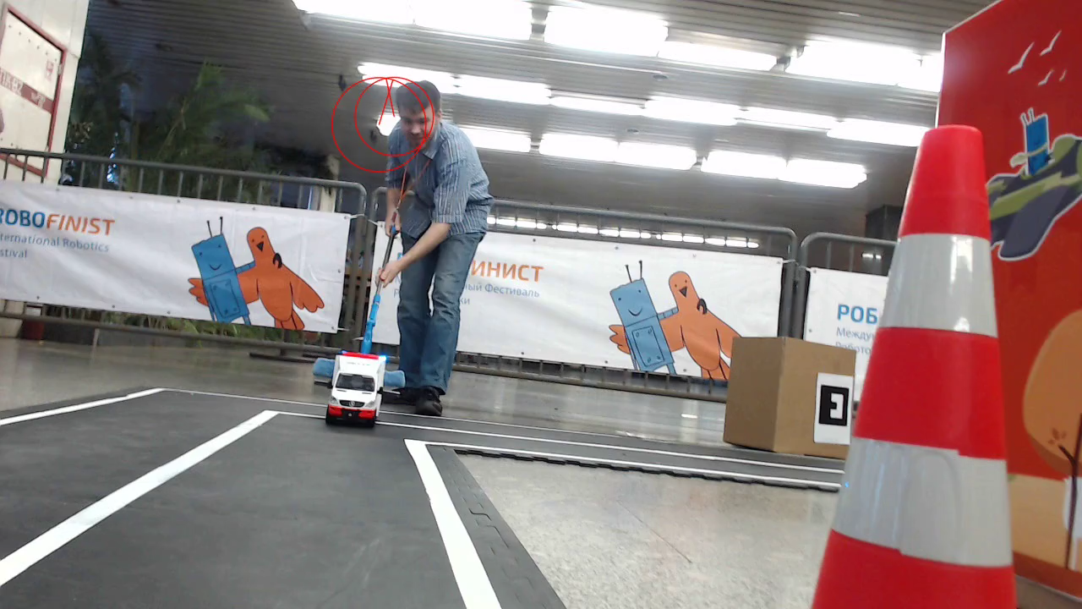
Image Handler: trigger

Slide 9
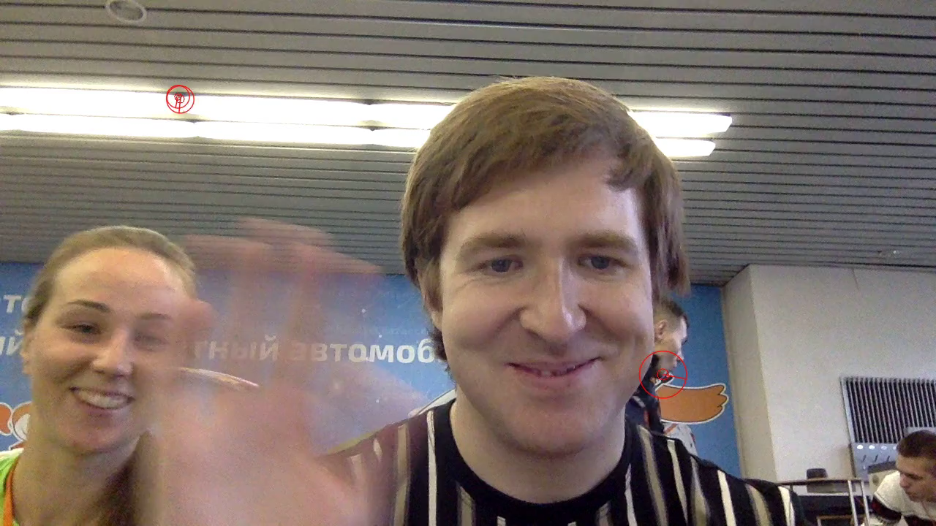
Image Handler: trigger

Slide 10

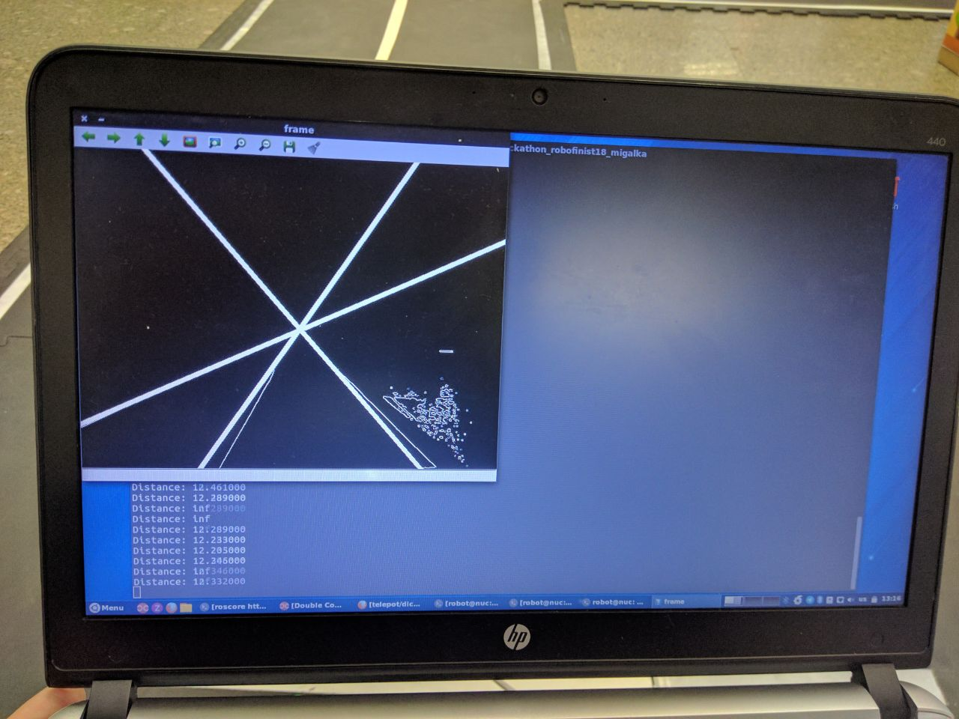
Image Handler: navigation
Image
Gauss Filter
Threshold Filter
Canny Filter
Hough Transform
Intersection point tracking

Slide 11

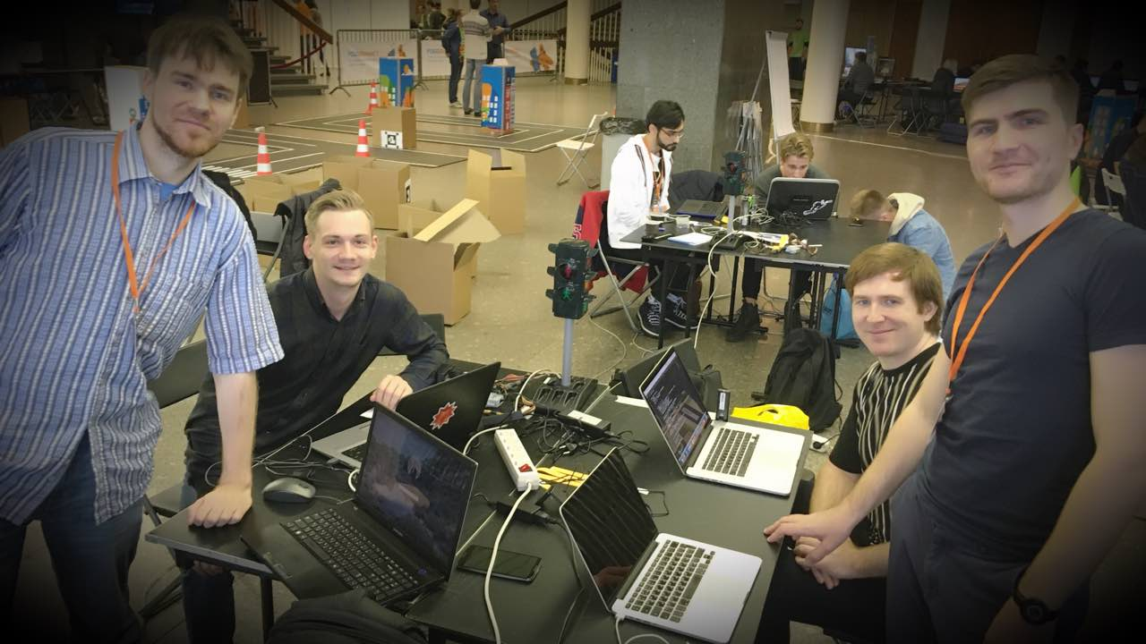
Thank you for your attention!

